Slide 2
Wide data format
Long data format
ID | Maths | Chemistry | Physics
AS131 | 50 | 70 | 45
AS132 | 60 | 80 | 68
ID | Subject | Marks
AS131 | Maths | 50
AS132 | Maths | 60
AS131 | Chemistry | 70
AS132 | Chemistry | 80
AS131 | Physics | 45
AS132 | Physics | 68

Slide 3
Make new variables
Subset columns
Subset rows
Summarise data

Slide 4
input %>% functionName( , ….)
other inputs
functionName(input, ….)
other inputs

Slide 7
visualise
communicate
import
tidy
transform
model

Slide 8





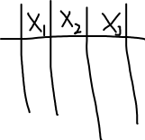
R

Slide 9
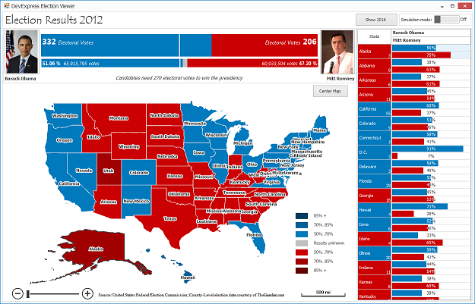
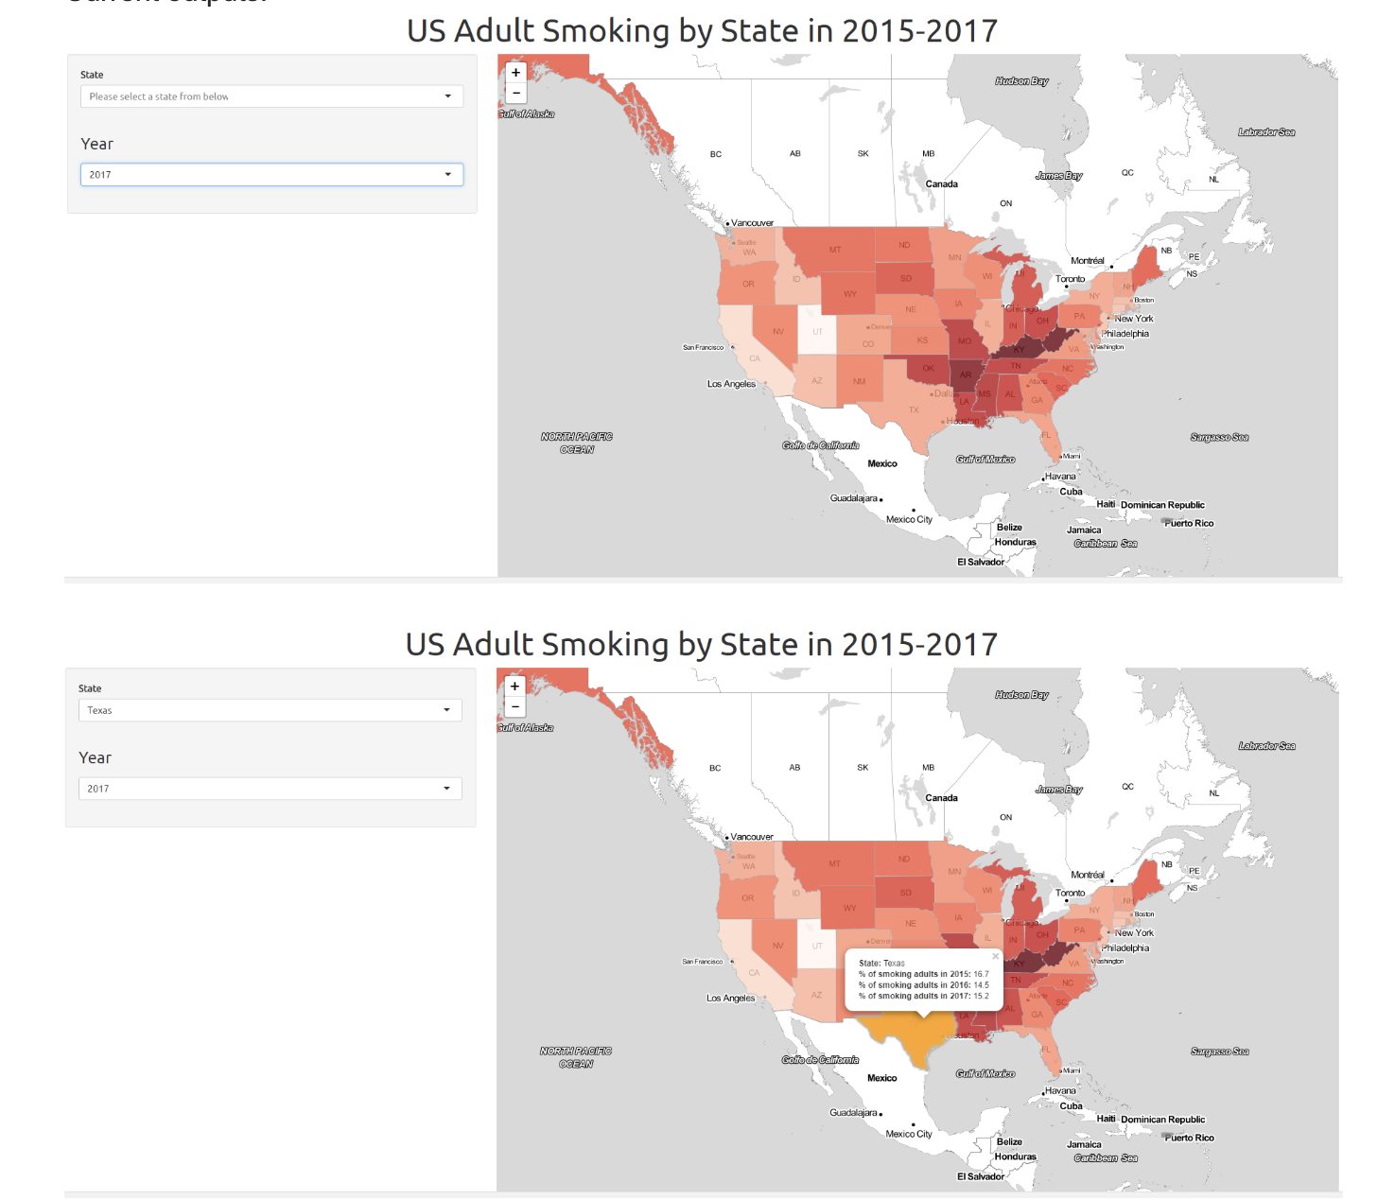
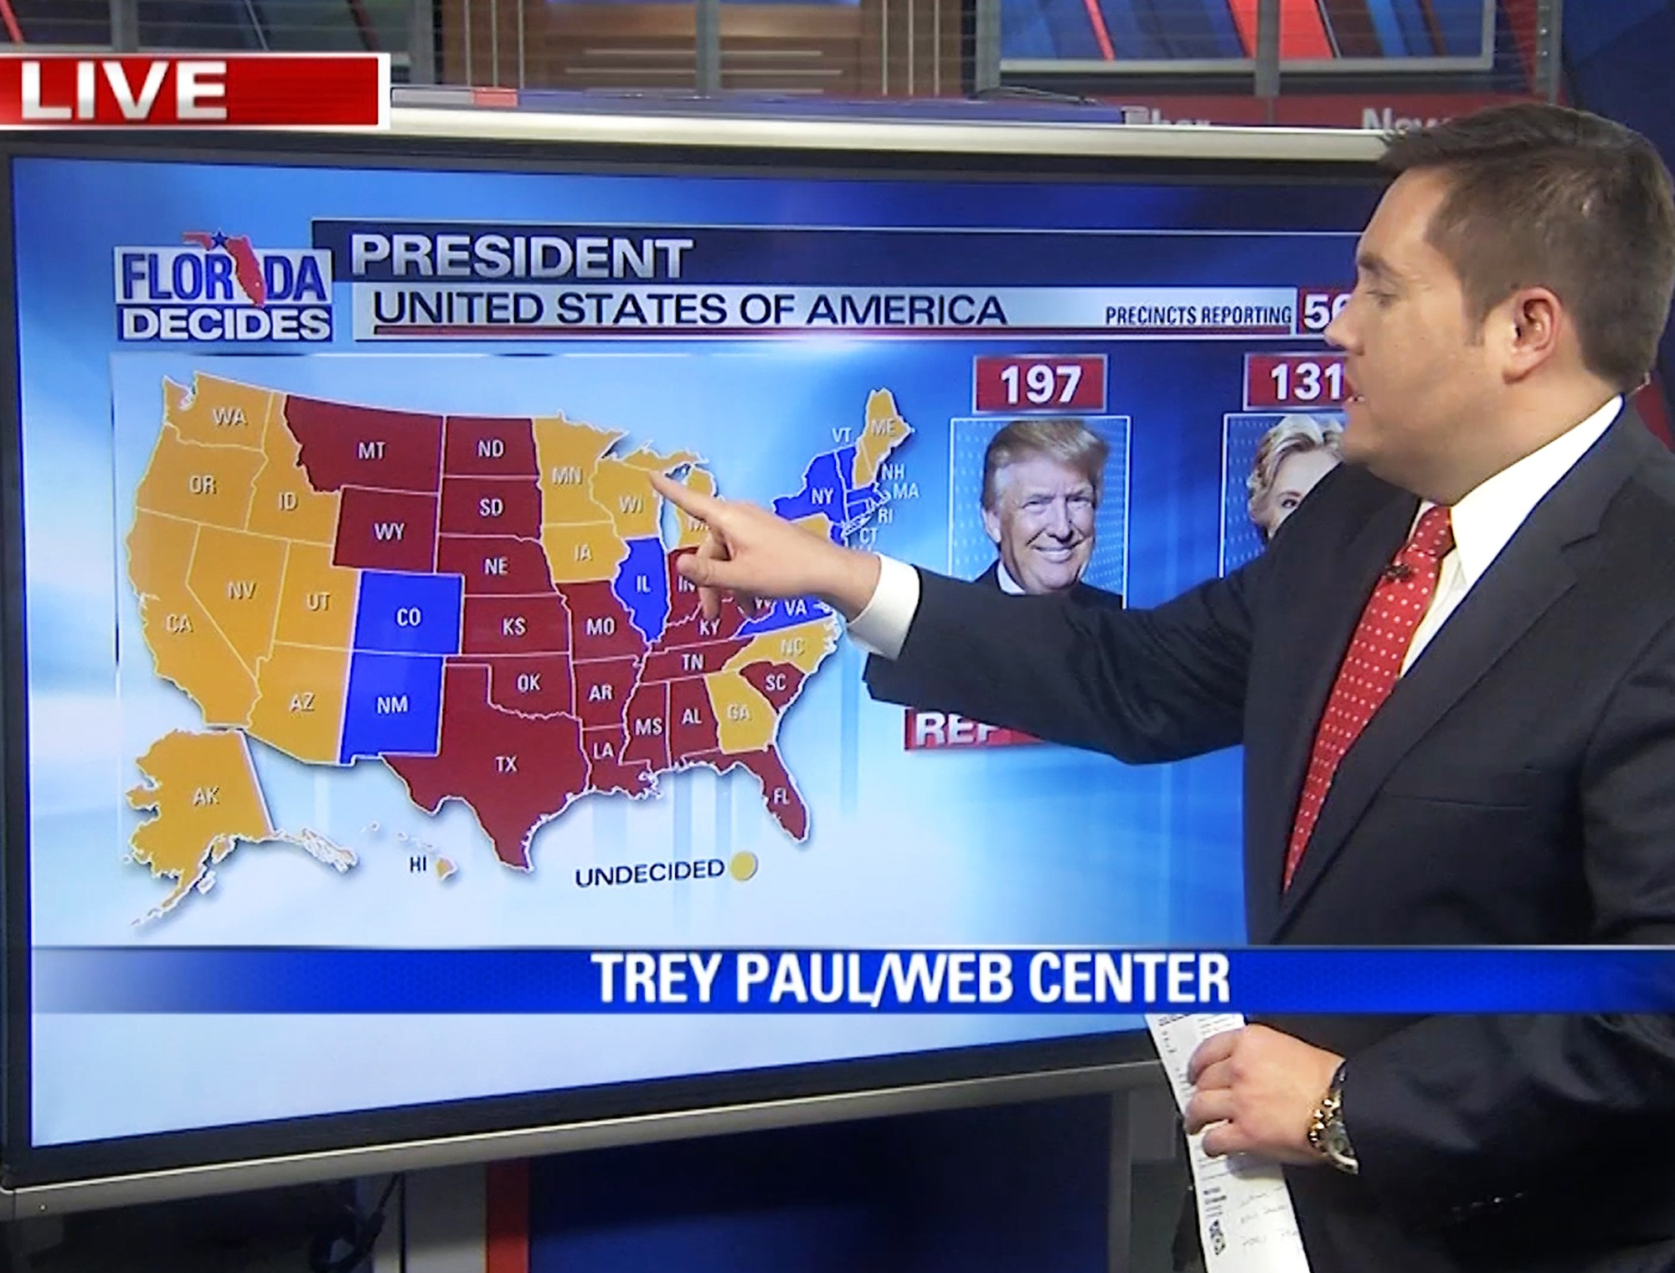
Exhibitory
Exploratory
Explanatory

